Slide 2
Pa$$w3rd c0mpl3X1ty
BRKSEC-1005v

Slide 3
Who am I and Why Should You Listen?
Kurt Grutzmacher -- kgrutzma@cisco.com
  10+ years penetration testing
  Federal Reserve System, Pacific Gas & Electric
  Security Posture Assessment Team Technical Lead
  I like to crack passwords

Slide 4
Session Objectives
What You Should Take Away….
Like all things in security there are no magic bullets
The “password problem” isn’t an easily answered one
Technology can help but should be critically reviewed before adoption
Interrogate technology options using risk management concepts
Password cracking tools and techniques are quite advanced today

Slide 5
Defining the Password Problem

Slide 6
2011 Hacking Methods
By Percent of Breaches
Source: http://www.verizonbusiness.com/resources/reports/rp_data-breach-investigations-report-2012_en_xg.pdf

Slide 7






Notable Account Breaches
 | 40,000,000 – Cleartext(!) December 25, 2011
 | 163,792 – Unsalted MD5 March 25, 2012 (Disputed)
 | 70,000,000 – Unknown cipher April 17, 2011
 | 35,000,000 – Unknown cipher November 6, 2011
 | 32,000,000 – Cleartext(!) December 14, 2009
 | 1,521,349 – Cleartext(!) February 21, 2012

Slide 8


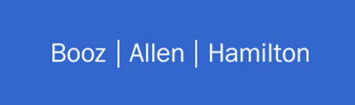


Even More Notable Account Breaches
 | 24,000,000 – Unknown cipher January 15, 2012
 | 6,425,861 – Cleartext(!) December 21, 2011
 | 67,195 – Unsalted MD5 July 11, 2011
 | 1,300,000 – Traditional DES December 11, 2010
 | 857,045 – Unsalted MD5 December 25, 2011

Slide 9
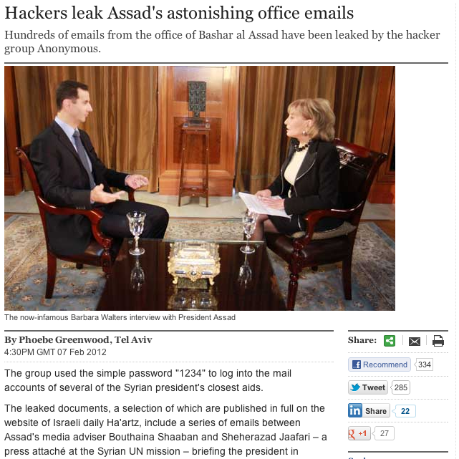

Slide 10
Compromising the Corporation

Slide 11
Amalgamated Infomatics, Inc.
(Totally Made Up)
A medium to large corporation with 5k-10k end users
Security conscious InfoSec department
  WPA Enterprise (802.1X) on Wireless
  Rolling out 802.1X on LAN
  Centralized authentication to Microsoft Active Directory
  Complex passwords are required
Still behind in some areas
  VPN access is not dual-factor (too costly, C-levels didn’t like the options)
  IT and InfoSec still don’t see eye-to-eye on important things
  Network and InfoSec rarely see eye-to-eye

Slide 12
Simplified Network Topology
Internal servers and VPN use AD for authentication and authorization
End users receive e-mail, browse Internet sites, etc.
Wireless uses WPA Enterprise (802.1X) authentication
DMZ and Internal protected with ASAs
Internal
DMZ
Internet

Slide 13
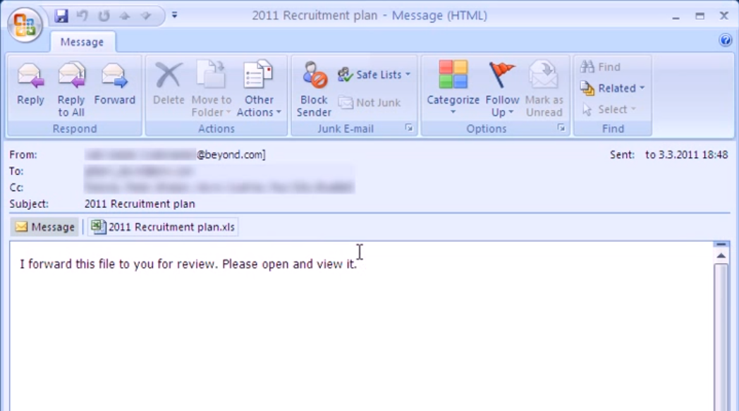
Suddenly, a Wild e-mail Appears!
https://www.youtube.com/watch?v=v8Ry1C8AnXk

Slide 14
Now We’re in Trouble
A few users opened the attachment (or visited a website, etc.)
A remote access trojan (RAT) is installed
Users have full administrative access to the PCs!
Now the attackers (may) have the user’s NTLM hash!
If they can crack it then they will have access to the corporate network at any time through wireless or VPN!
!
!!!
!!!OMG!!!

Slide 15



But What About….
A few slides back was a short list of account breaches
What if an employee can be linked between one of those lists and their corporate login? (Facebook, Spoke, etc.)
What if that person uses the same password or a variation?
It happens….

Slide 16
What are complex passwords?

Slide 17
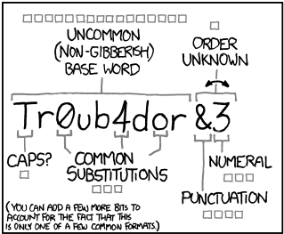
Defining Complexity
Characteristically complex
  Not found in a dictionary or easily permutable
  Mixture of character types (upper, lower, number, special)
Length
  Minimum 8 characters, perhaps more
Unique
  Historical
  Per system / environment
  No easily guessable pattern rotation

Slide 18
Microsoft Defining Complexity
http://technet.microsoft.com/en-us/library/cc756109(v=ws.10).aspx
Is at least seven characters long.
Does not contain your user name, real name, or company name.
Does not contain a complete dictionary word.
Is significantly different from previous passwords. Passwords that increment (Password1, Password2, Password3 ...) are not strong.
Contains characters from each of the following four groups:
  Uppercase letters
  Lowercase letters
  Numerals
  Symbols found on the keyboard

Slide 19
That’s all Well and Good…
What hinders adoption of complexity?
  Difficult to remember
  Unique requirements for different sites or software
  Not everyone is that creative
Microsoft’s example of a strong password: J*p2leO4>F
If an attacker knows the complexity guidelines they can “crack smarter” and lower the entropy pool for brute forcing.

Slide 20
Through 20 years of effort, we’ve successfully trained everyone to use passwords that are hard for humans to remember but easy for computers to guess.
https://xkcd.com/936/

Slide 21
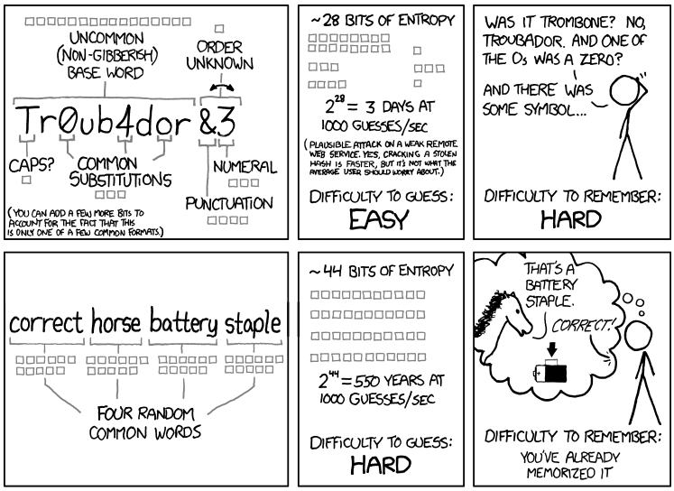
https://xkcd.com/936/

Slide 22
Are There Any Solutions?
At Least to Make Managing Complexity Less Complex?
Tools that automatically generate complex passwords
Tools that gen and store passwords “securely”
Writing down passwords on paper and keeping them secure
Cheat sheets
Passphrases (but be careful with them):
  http://arstechnica.com/business/news/2012/03/passphrases-only-marginally-more-secure-than-passwords-because-of-poor-choices.ars
  Natural language tendencies can be predicted
  Multiple random words or adding additional entropy helps dramatically
  “Forget& 8Patronize”

Slide 23
What About Two-factor?
Can be difficult to deploy
People don’t like having to jump through hoops just to view an internal website
Cost of hardware tokens can be prohibitive
Smartphone-based OTP is on the rise (hooray!)
  Google Authenticator (https://code.google.com/p/google-authenticator/)
  DuoSecurity (http://www.duosecurity.com/)

Slide 24
What Are “Cheat Sheets?”
A page or small booklet with random characters in a grid
Each page is unique (or should be!)
You pick a starting point on the grid and make a pattern
Use the characters from the pattern as your password or as part of your passphrase
Do not mark your sheet to identify where your pattern starts

Slide 25
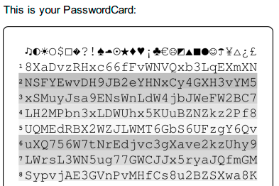
Example Password Card / Cheat Sheet
https://www.passwordcard.org/en

Slide 26
Secure Password Managers
(Many to Choose from, These are Just a Few)
Synchronizes between smartphone and workstation / cloud
Integrated browser support to only have to remember main passphrase
Some of the top Password Managers:
  1Password (https://agilebits.com/onepassword)
  LastPass (https://lastpass.com/)
  PasswordSafe (http://passwordsafe.sourceforge.net/)
  KeyPass (http://keepass.info/ and https://www.keepassx.org/)
Use a strong and complex passphrase to protect your data
These are your secret codes to everything
Caveat emptor!

Slide 27
Issues with “Secure Password Managers”
Smartphone Versions Are Not Too Smart!
Elcomsoft analyzed 17 Apple iOS and BlackBerry applications designed to facilitate storing and management of passwords.
Focused on the security of “data at rest”
Some provided absolutely NO protection!
Threat modeling and Risk identification:
  What secrets am I trying to protect?
  Where are these secrets stored?
  What methods are being used to protect them?
Source: http://www.elcomsoft.com/WP/BH-EU-2012-WP.pdf

Slide 28
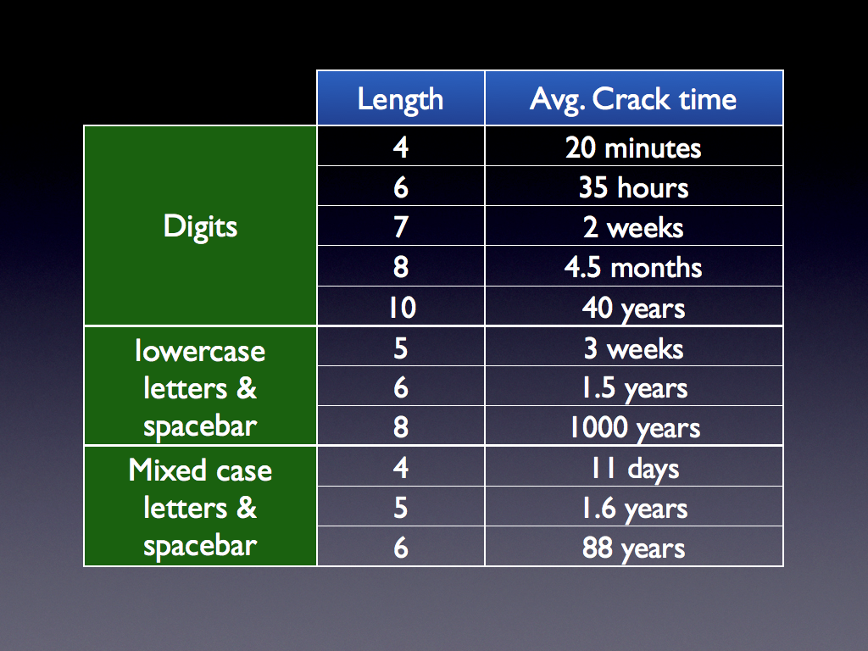
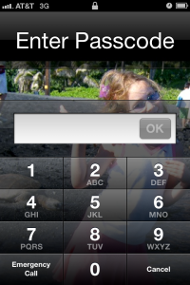
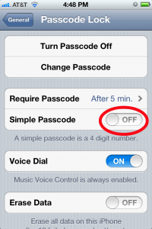
Time to Crack Phone Passcodes
http://blog.agilebits.com/2012/03/30/the-abcs-of-xry-not-so-simple-passcodes/

Slide 29
Risk Identification

Slide 30
You can’t effectively and consistently manage what you can’t measure, and you can’t measure what you haven’t defined…

Slide 31
What is Risk?
The probable frequency and probable magnitude of future loss
  How frequently something bad is likely to happen
  How much loss is likely to result
Risk is not a single thing – it is a derived value
  Threat event frequency
  Vulnerability
  Asset value and liability characteristics

Slide 32
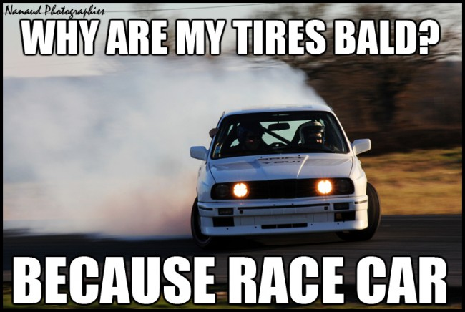
The Bald Tire Scenario
As we proceed through each of the following steps ask yourself “How much risk is associated with what’s being described?”

Slide 33
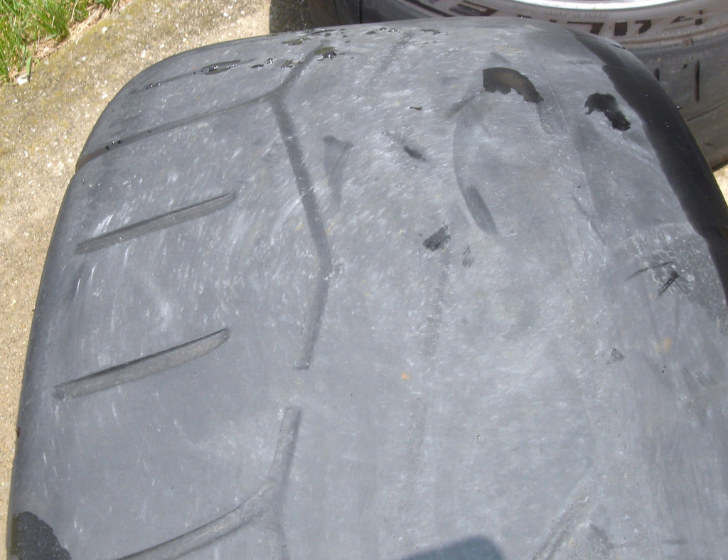
Imagine a Bald Tire
…So Bald You Can Barely Tell It Had Tread At All
How much risk is there?

Slide 34

Imagine it Hanging from a Tree by a Rope
How much risk is there?

Slide 35
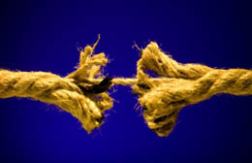
Imagine the Rope is Frayed About ½ Through
…Just Below Where it’s Tied to the Branch
Now how much risk is there?

Slide 36
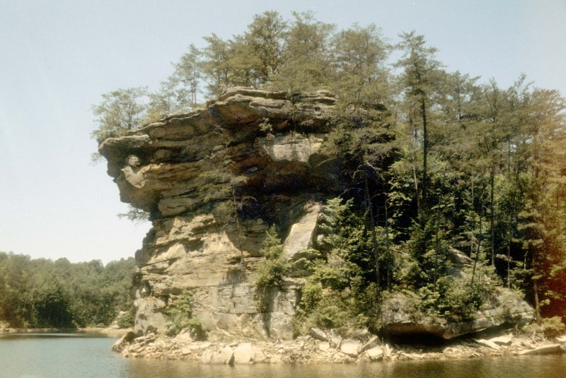
Image the Tire Swing is Over an 80ft Cliff
…With Sharp Rocks and Shallow Water!
Now how much risk is there?

Slide 37
Bald Tire Scenario Analysis
The asset is the bald tire
The threat is the earth and the force of gravity that it applies to the tire and rope
The potential vulnerability is the frayed rope (disregarding the potential for a rotten tree branch, overweight person, etc.)
The idea of risk changes as additional knowledge is gained

Slide 38
How Does This Relate to Passwords?
You can’t have significant risk without the potential for significant losses
  If the asset is not worth much, the risk is not high
If an asset requires passwords then there is some perceived value.
The loss may be secondary (e.g. falling onto the sharp rocks)
Apply risk analysis to password complexity choices!
What is the risk of one router’s enable password being compromised?
What is the risk of your on-line bank account being compromised?

Slide 39
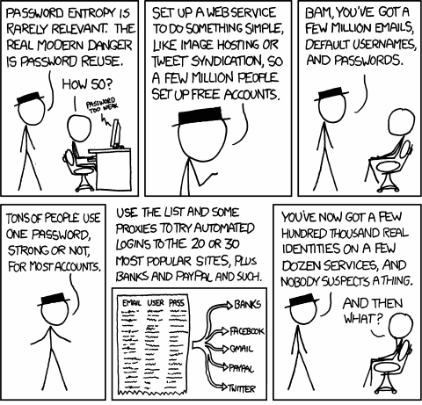
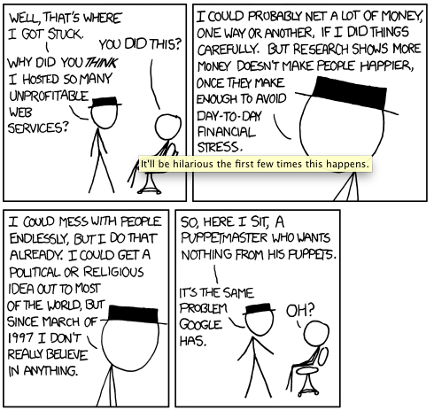
Password Reuse
A True Secondary Loss
https://xkcd.com/792/

Slide 40
Enable Password Scenario

Slide 41
Prediction is very difficult, especially about the future
Niels Bohr

Slide 42
What is the Risk?
Possibility is 100% the threat actor will recover the password given enough time and resources
  Possibility is binary: it is or it isn’t going to happen
Probability can vary based on multiple risk factors:
  Complexity of the encryption method used
  Likelihood of the password being brute forced
  Likelihood of the password being in a dictionary
  Likelihood of the password being a permutation of a dictionary entry
The value of the outcome from the vulnerability will vary
  Enable password the same on multiple routers?

Slide 43
Don’t Stop at the Enable Password
You’d be surprised how many times we gain access to network equipment through simple mistakes:
  Imagine a switch installed in a closet back in 2001
  The switch hasn’t been upgraded since installed (hey, it works)
  It is configured with your “standard device configuration”
  …and the IOS HTTP server is on by default!
  …and it’s vulnerable to /exec/level/16!
What is the main risk in this scenario now?
What’s the secondary risk?

Slide 44
The “Enable Password” Scenario
Threat:
  A hacker obtained a router configuration file
Vulnerability:
  Recovery of cleartext passwords from encrypted ciphertext (enable secret)
  SNMP community strings and ACLs
Asset:
  Passwords to login and change router configurations
How do you now want to generate and store enable passwords for your networking devices?

Slide 45
Brute Force Cracking Cisco Hashes
Using 3 nVidia GTX 580 Cards and oclHashCat Plus
Cisco-PIX/ASA MD5
  4317.3M cracks per second
  Characters: Lowercase/Uppercase/Number
  Length: 8
  Time: 18 hours
Cisco-IOS MD5 (enable, password 5)
  1,439.2k cracks per second
  Characters: Lowercase/Uppercase/Number
  Length: 8
  Time: 40 days

Slide 46
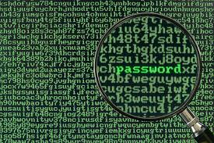
Crackin’ Passwords

Slide 47
“Treat your password like your toothbrush. Don’t let anybody else use it, and get a new one every six months.”
Clifford Stoll
Author

Slide 48
Preface to Cracking
There are many examples and other really good presentations on how to crack passwords effectively
This will just be covering some general statistics on the mechanics
Further resources:
  https://www.youtube.com/watch?v=4HlmZmSocCM&hd=1
  http://thepasswordproject.com/

Slide 49
DEFCON “Crack Me If You Can”
https://contest.korelogic.com/
Started in 2010 by KoreLogic, Inc
Created to help push the envelope of password cracking techniques and methodologies
KoreLogic creates a “realistic” list of passwords and encrypts them with real-world encryption algorithms
Teams are given the list at the same time and awarded points for recovering the cleartext
48 HOURS to crack and score!
Results were closely aligned to real-world scenarios

Slide 50
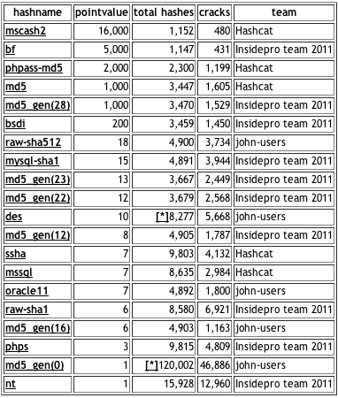
2011 Statistics

Slide 51
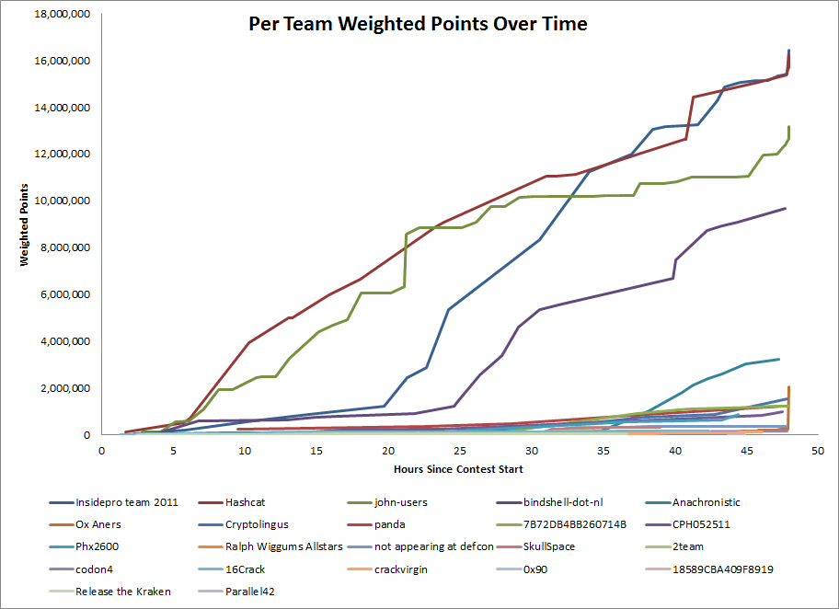
2011 Team Points Over Time

Slide 52
Graphics Processing Units and You
The GPU has revolutionized password cracking
From brute forcing to Rainbow Table generation, GPUs can dramatically decrease computation times
A single nVidia GTX 580 can take less than 1 day to exhaust a keyspace of 69 characters, up to 8 characters in length
Change the length to 9 and time increases to 2½ months
Each additional GPU will cut the time required dramatically

Slide 53
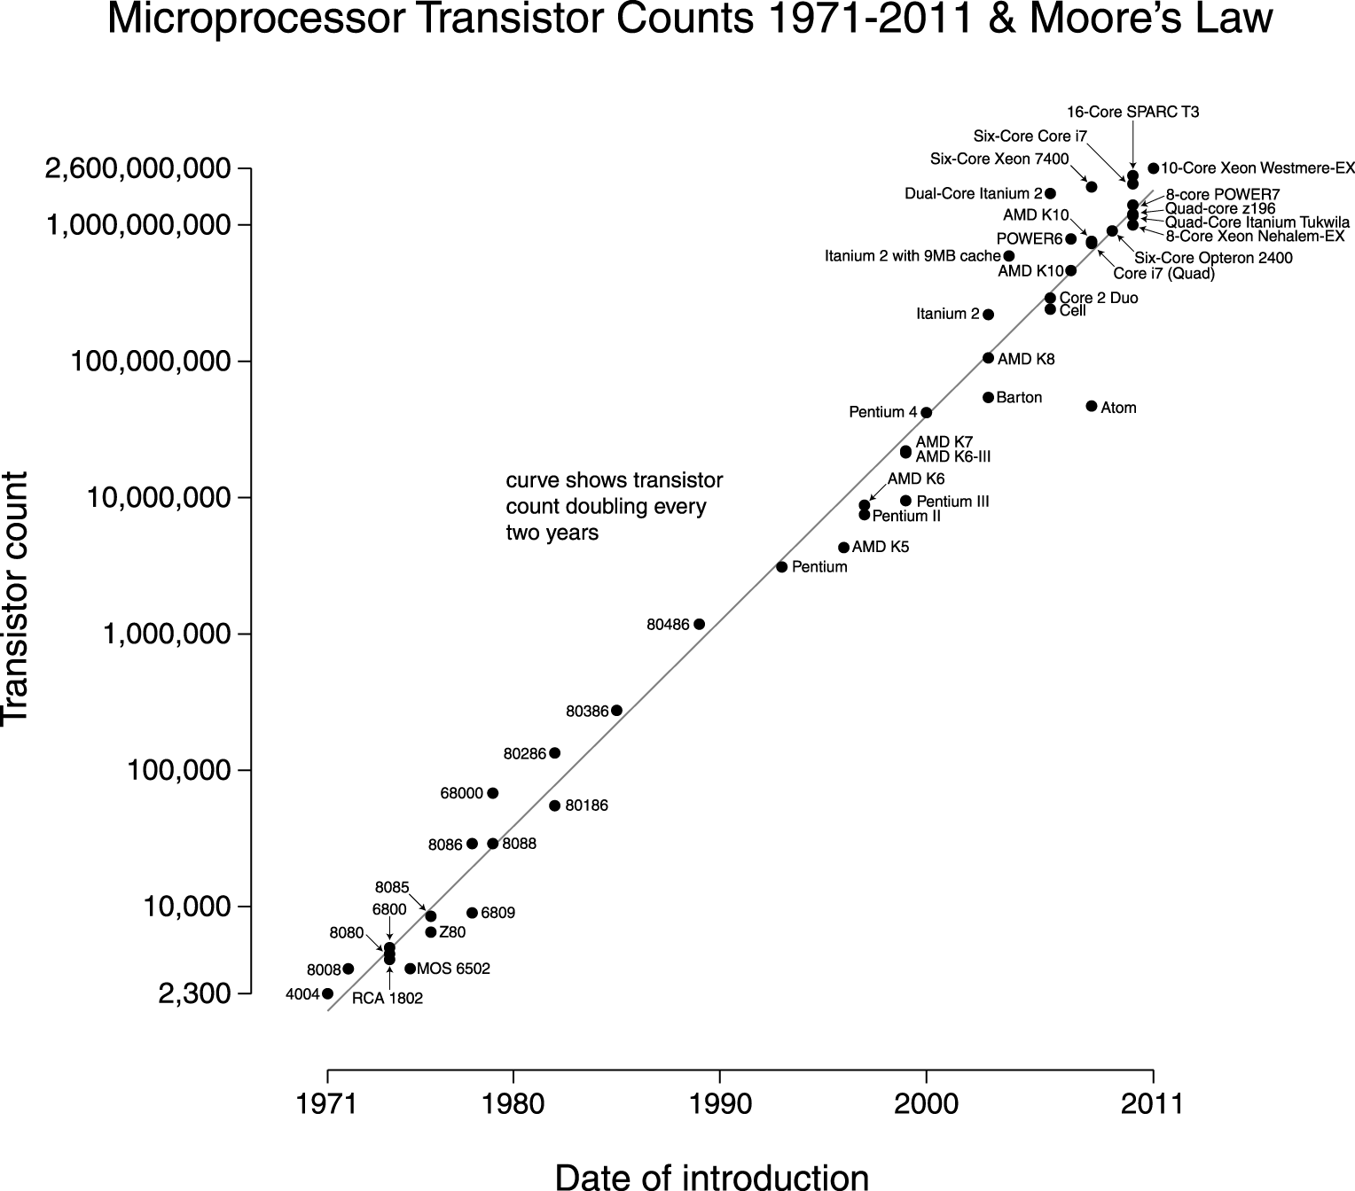
Moore’s Law – # of Transistors

Slide 54
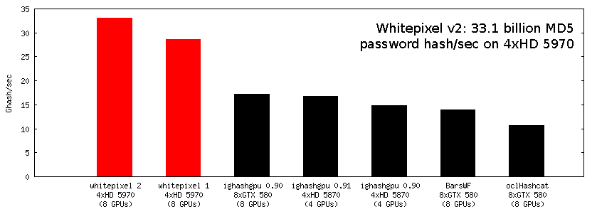
MD5 Cracks Per Second (in Billions)
http://whitepixel.zorinaq.com/ - ATI Video Cards, Single Hash Cracker

Slide 55
John The Ripper
The Gold Standard Of Password Cracking
http://www.openwall.com/john/
Jumbo patch adds support for many algorithms
CPU, OpenMP and GPU (OpenCL/CUDA) support
Multiplatform support
Multiple modes of cracking (wordlist, rules, brute force/single)
Actively and openly developed (john-dev mailing list)
Great for managing what’s cracked and what’s left
  ./john –show:left –fo:ntlm –pot:ad.pot ad_list.pwdump | cut –d\$ -f3
  ./john –show –fo:ntlm –pot:ad.pot ad_list.pwdump

Slide 56
oclHashCat Plus
http://hashcat.net/oclhashcat-plus/
Supports Up to 16 GPUs, 24 million hashes at once
Closed source but actively developed
20+ Algorithms supported
Wordlists+rules, bruteforce, hybrid, permutation attacks
CUDA and OpenCL support in Linux and Windows
Performance (single ATI hd5970 with standard clock core):
    MD5: 6,253.8M cracks/second
    NTLM: 10,037.9M cracks/second
    PIX MD5: 6,296.7M cracks/second

Slide 57
Wordlists!
/usr/share/dict Doesn’t Cut It Anymore
http://dumps.wikimedia.org/enwiktionary/
http://www.skullsecurity.org/blog/2010/return-of-the-facebook-snatchers
http://www.skullsecurity.org/wiki/index.php/Passwords
http://www.insidepro.com/eng/download.shtml
…many more available, just google it!

Slide 58
Brute forcing MD5 with 3 GTX 580s
7 Character Length, upper/lower/number/special: 69,833,729,609,375 Combos
# ./cudaHashcat-plus64.bin -m 0 -a 3 -1 ?l?u?d?s –o cracked.txt md5_test.txt ?1?1?1?1?1?1?1
cudaHashcat-plus v0.07 by atom starting...
Hashes: 47020
Unique digests: 47020
Bitmaps: 19 bits, 524288 entries, 0x0007ffff mask, 2097152 bytes
GPU-Loops: 128
GPU-Accel: 8
Password lengths range: 1 - 15
Platform: NVidia compatible platform found
Watchdog: Temperature limit set to 90c
Device #1: GeForce GTX 580, 1535MB, 1544Mhz, 16MCU
Device #2: GeForce GTX 580, 1535MB, 1544Mhz, 16MCU
Device #3: GeForce GTX 580, 1535MB, 1544Mhz, 16MCU
Device #1: Allocating 19MB host-memory
Device #1: Kernel ./kernels/4318/m0000_a3.sm_20.64.cubin
Device #2: Allocating 19MB host-memory
Device #2: Kernel ./kernels/4318/m0000_a3.sm_20.64.cubin
Device #3: Allocating 19MB host-memory
Device #3: Kernel ./kernels/4318/m0000_a3.sm_20.64.cubin
[s]tatus [p]ause [r]esume [q]uit => s
Status.......: Running
Input.Mode...: Mask (?1?1?1?1?1?1?1)
Hash.Type....: MD5
Time.Running.: 0 secs
Time.Left....: 6 hours, 30 mins
Time.Util....: 582.4ms/11.4ms Real/CPU, 2.0% idle
Speed........: 2981.4M c/s Real, 3057.2M c/s GPU
Recovered....: 1/47020 Digests, 0/1 Salts
Progress.....: 1736441856/69833729609375 (0.00%)
Rejected.....: 0/1736441856 (0.00%)
HW.Monitor.#1: 0% GPU, 74c Temp
HW.Monitor.#2: 0% GPU, 71c Temp
HW.Monitor.#3: 0% GPU, 68c Temp
Character set:
ABCDEFGHIJLMNOPQRSTUVWXYZ
abcdefghijklmnopqrstuvwxyz
0123456789
!"#$%&'()*+,-./:;<=>?@[\]^_`{|}~

Slide 59
Brute forcing NTLM with 3 GTX 580s
8 Character Length, upper/lower/number/special: 6,634,204,312,890,625 Combos
# ./cudaHashcat-plus64.bin -m 1000 -a 3 -1 ?l?u?d?s -o cracked.txt ntlm.txt ?1?1?1?1?1?1?1?1
cudaHashcat-plus v0.07 by atom starting...
Hashes: 10578
Unique digests: 10578
Bitmaps: 17 bits, 131072 entries, 0x0001ffff mask, 524288 bytes
GPU-Loops: 128
GPU-Accel: 8
Password lengths range: 1 - 15
Platform: NVidia compatible platform found
Watchdog: Temperature limit set to 90c
Device #1: GeForce GTX 580, 1535MB, 1544Mhz, 16MCU
Device #2: GeForce GTX 580, 1535MB, 1544Mhz, 16MCU
Device #3: GeForce GTX 580, 1535MB, 1544Mhz, 16MCU
Device #1: Allocating 19MB host-memory
Device #1: Kernel ./kernels/4318/m1000_a3.sm_20.64.cubin
Device #2: Allocating 19MB host-memory
Device #2: Kernel ./kernels/4318/m1000_a3.sm_20.64.cubin
Device #3: Allocating 19MB host-memory
Device #3: Kernel ./kernels/4318/m1000_a3.sm_20.64.cubin
[s]tatus [p]ause [r]esume [q]uit => s
Status.......: Running
Input.Mode...: Mask (?1?1?1?1?1?1?1)
Hash.Type....: NTLM
Time.Running.: 1 sec
Time.Left....: 18 days, 22 hours
Time.Util....: 1254.1ms/14.5ms Real/CPU, 1.2% idle
Speed........: 4153.8M c/s Real, 4246.5M c/s GPU
Recovered....: 0/10578 Digests, 0/1 Salts
Progress.....: 5209325568/6634204312890625 (0.01%)
Rejected.....: 0/5209325568 (0.00%)
HW.Monitor.#1: 0% GPU, 71c Temp
HW.Monitor.#2: 0% GPU, 68c Temp
HW.Monitor.#3: 0% GPU, 65c Temp
Character set:
ABCDEFGHIJLMNOPQRSTUVWXYZ
abcdefghijklmnopqrstuvwxyz
0123456789
!"#$%&'()*+,-./:;<=>?@[\]^_`{|}~

Slide 60
Crack Smarter, Crack Better
Brute forcing used as a “last resort” for long character lengths
Adding more cards or distributing across multiple systems will lower the time required to complete the keyspace
Dictionary words + permutations usually are more effective
  People recall names and things better than just random characters
  Simple permutations like adding “1@” to the beginning and end of a word works!
Attackers generally have lots of time on their hands to crack

Slide 61
Build Your Own Cracking Rig
(It is Cheaper in the Long Run)
Cost of running 4 Amazon GPU instances for 5 days is $1,008!
Use cards better suited for hash cracking:
  AMD/ATI Radeon HD 7970: $500-600
  nVidia GTX 580: $500-600
ATX motherboard, low power CPU, memory, case, power supply
Guesstimate around $130/month for power
When new cards are released, add or replace the old ones (eBay!)
Total initial investment: $2,700

Slide 62
Rainbow Tables
Storage Space vs. Computing Time
Pre-computed tables of a keyspace with an encryption cipher
Limited only by the amount of disk space you have
LANMAN tables can achieve nearly 99.999% success rate
3.5TB of Rainbow Tables can be purchased for US$900
  http://www.freerainbowtables.com/en/tables2/
Also downloadable via Torrent or (really slow) HTTP
GPU-enabled Rainbow Tables available:
  http://www.cryptohaze.com/gpurainbowcracker.php

Slide 63
Demo: CPU vs. GPU WPA Cracking

Slide 64
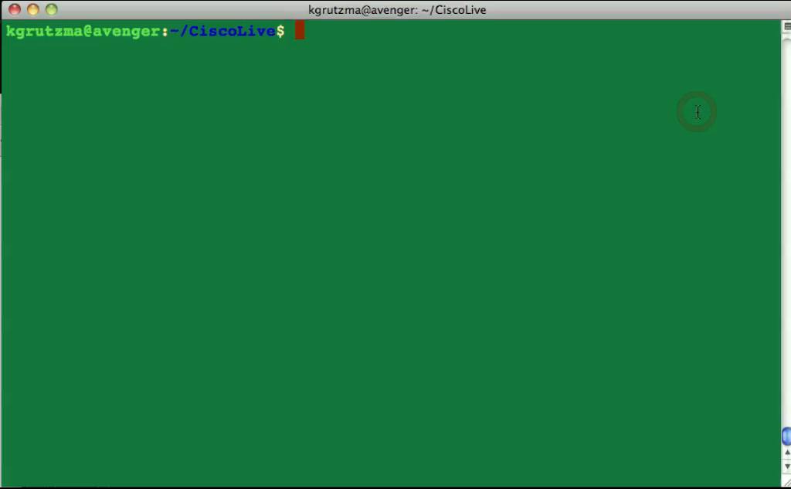
WPA Speed Comparison: CPU vs. GPU

Slide 65
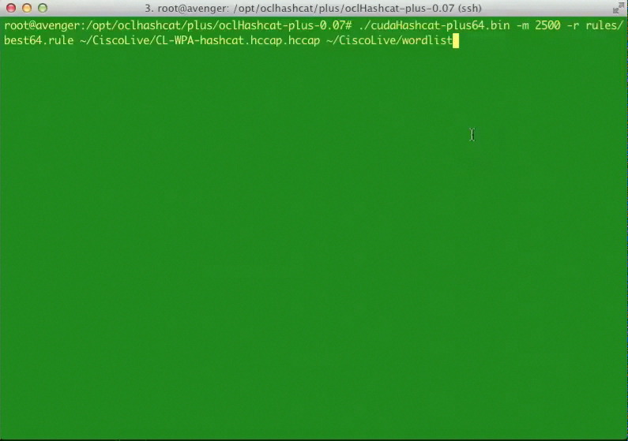
WPA with HashCat Plus

Slide 66
To summarize…

Slide 67
To Summarize
Password complexity, while required, is difficult to manage
Account breaches happen all the time and will continue
Cracking speeds are increasing dramatically every year
Password re-use is a serious threat
Solutions do exist to assist with smart application of complex passwords
Use threat/risk management techniques where applicable
Bald Tire Scenario!

Slide 68
Final Thoughts
Get hands-on experience with the Walk-in Labs located in World of Solutions, booth 1042
Come see demos of many key solutions and products in the main Cisco booth 2924
Visit www.ciscoLive365.com after the event for updated PDFs, on-demand session videos, networking, and more!
Follow Cisco Live! using social media:
  Facebook: https://www.facebook.com/ciscoliveus
  Twitter: https://twitter.com/#!/CiscoLive
  LinkedIn Group: http://linkd.in/CiscoLI

